Slide 1
Resurrecting the SEPEP Model of instruction.
A tonic for Year 9 Apathy in Physical Education Classes

Slide 2
What professional teaching standards are you addressing?
The SEPEP model itself addresses
1.1 Physical, social and intellectual development and characteristics of students
2.1 Content and teaching strategies of the teaching area
2.6 Information and Communication Technology (ICT)
The workshop directly addresses
3.1 Establish challenging learning goals
3.2 Plan, structure and sequence learning programs
3.6 Evaluate and improve teaching programs

Slide 3
WHAT
WHY
HOW

Slide 4
WHAT
Sport Education in Physical Education Program
Developed by Siedentop (1994), SEPEP is a curriculum model that allows for the development of social, cognitive and sporting skills within students
(Alexander, Taggart, Medland and Thorpe 1995).

Slide 5
WHAT
Sport Education in Physical Education Program
‘One of the key aspects of the SEPEP model is that students participate in roles which are utilised in the sport environment. These can include coach, referee/umpire, publicity officer, game analyser etc’.
(Webb, Pearson, Forrest 2009)

Slide 6
WHAT
Learn More
http://ehlt.flinders.edu.au/education/DLiT/2008/Sepep/What%20is%20Sepep.html
http://www.curriculumsupport.education.nsw.gov.au/secondary/pdhpe/assets/pdf/pa_004.pdf
http://www.achper.org.au/blog/blog-sepep-revisited
http://ro.uow.edu.au/cgi/viewcontent.cgi?article=1094&context=edupapers

Slide 7
WHAT
Learn More
@MrMetcalfPE
ThePhysicalEducator.com

Slide 8
WHY
Apathy
Student Centred
Autonomy / Mastery / Purpose = Motivation

Slide 9
WHY

Slide 10
How
3 Year process of refining the model
Flexibility to fit your school context

Slide 11
How

Slide 12
How
Grading Day
Introduction and explanation of unit
Split into random teams (Teamshake app)
Play games
Assign grading stats to make 4 even squads

Slide 13
How
Squad Selection Announcement
OneNote
Message Board
Email
Moodle

Slide 14
How
Roles and Responsibilities
School Context Activity:
What Roles and Responsibilities might work at your school?
e.g. Coach, Media, Strength & Conditioning, Equipment, Video Analyser

Slide 15
How
Roles and Responsibilities
Head Coach | Assistant Coach | Captain | Equipment Officers (2) | Referee | Media (2) | Communications
Responsible for the overall vision and strategy of the team. e.g. formations, style of play, who plays where. Also responsible for co-ordinating sessions with assistant coach | Responsible for assisting the coach in creating and delivering sessions that work towards the vision and strategy of the head coach | Responsible for team cohesion, ensuring that all players listen to coaches. Conflict resolution between players. Leading the team on the field, inspiring players through work ethic and attitude | Responsible for communicating with coaches and ensuring all equipment is set up and ready to go at start of session. Responsible for packing up equipment tidily in store cupboard. | Responsible for learning and understanding rules of the game. Responsible for officiating friendlies and finals matches. | Responsible for documenting the season via text, photo's and videos. Responsible for creating pre-season report. Mid -season report and end of season report. | Responsible for liaising with teachers and disseminating information appropriately

Slide 16
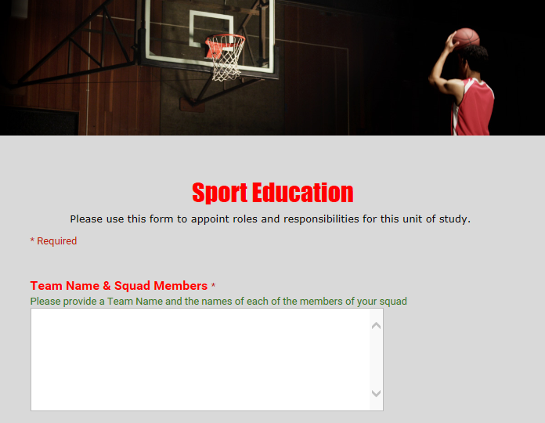
How
Roles and Responsibilities
Assigning Roles For Season
Example Google Form
http://goo.gl/forms/q0LllnU8sl

Slide 17
How
Pre Season
3 – 5 Lessons
Specific Weekly Focus to Communications Officer
Fitness / Skill / Tactical
Traditional v TGfU Approach to training

Slide 18
How
Pre Season
Hello communication officers
The Plan for pre- season session 2:
Coaches need to start selecting positions, so will need to organise a small game with their own squad to help facilitate this.
Focus of tomorrows session should be MAINTAINING POSESSION.
You may wish to check out this website for ideas http://www.sportplan.net/drills/Football/
Equipment officers will need to come to the PDHPE staffroom before school and get the keys so they can get up to oval and start getting the equipment ready.
Please distribute this message to your coaches and equipment officers.
James Muir HOC PDHPE
 | The Hills Grammar School Independent, Co-educational, Non-denominational, Pre-kinder to Year 12 43 Kenthurst Road, Kenthurst NSW 2156 Telephone +61 2 9654 5339 Facsimile +61 2 9654 5226 www.hillsgrammar.nsw.edu.au

Slide 19
How
Pre Season
Teacher Role:
Liaise with coaches and assist where appropriate
Provide weekly feedback for squads and / or individuals
Assist with ICT needs

Slide 20
How
Pre Season Friendlies
Towards the end of preseason (lessons 3 to 5)
Students were able to organise friendly games against other squads if they desired.
Game design (e.g. full squad or small sided) was left to negotiation
Some squads preferred to spend extra time training

Slide 21
How
Season Pool Games (round robin)
Time dependent:
Warm up as squad 10 mins
1 or 2 Pool Games per period based
Self refereed, scored, videoed (if applicable)
Number of subs negotiated depending on squad size that day

Slide 22
How
Season Pool Games and Finals Series
Demetri | 2 | Tegel | 1
Smith | 1 | Moussa | 1
Team | Played | F | A | GD | points
Moussa | 3 | 2 | 1 | 1 | 7
Demetri | 3 | 2 | 1 | 1 | 4
Smith | 3 | 1 | 1 | 0 | 5
Tegel | 3 | 1 | 3 | -2 | 0
Demetri | 0 | Smith | 0
Tegel | 0 | Moussa | 1
Semi Finals
Tegel | 0 | Smith | 3
Moussa | 3 | Demetri | 0
1st | Moussa | 0 | 4th | Tegel | 1
2nd | Smith | 0 | 3rd | Demetri | 3
3rd v 4th
Moussa | 1 | Smith | 0
Grand Final
Tegel | 1 | Demetri` | 0

Slide 23
How
Post Season Presentation of Awards
Student votes for MVP
Coaches vote for Coaches Award
Teachers vote for Coach of the Season and All Star Team

Slide 24
How
ICT Integration
Bam Video Delay
Huddle / Coaches Eye
Video Tagger
Kinovea
Admin: Google Forms, OneNote, Teamer (Remind), corel video studio, instagram, weebly, seesaw

Slide 25
How
Assessment
Over To You
How Would You Assess This Unit?

Slide 26
How
Assessment
Assessment Based on Role and Performance?
Generic Practical Assessment Rubric (next Slide)
Teacher moderation for consistency

Slide 28
How could you implement sepep into your program?
What sports might work well?
How long / short could it be?
How might it work for an Athletics Unit ?

